Slide 1
Document/sentence similarity solution using open source NLP libraries, frameworks and datasets
Pydata 2022
By Ade Idowu
Credit Suisse

Slide 2
Agenda
Introduction
What is STS - Semantic Textual Similarity
Textural similarity measures
Sentence pre-processing using NLP
Feature engineering using Sentence Embedding models
Visualization/Validation of findings
Demo Problems & Datasets used in this tutorial
Q & A

Slide 3
Introduction
Growing need to develop robust semantic document/text similarity solutions:
Recommendation Systems
Search Engines
News Aggregator Systems
Automated Recruitment Systems
Biomedical informatics eg. used to compare genes and proteins based on the similarity of their functions
And so on…

Slide 4
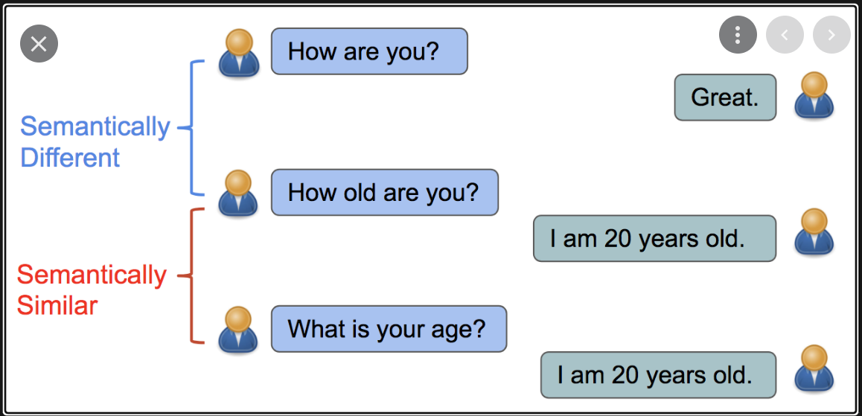
Introduction (continued..)
It is all about Semantics!!

Slide 5
What is STS - Semantic Textual Similarity
STS is a solution that deals with determining how similar two pieces of texts (sentences/phrases/paragraphs) are to each other
According to wikipedia the distance measured in STS is based on the likeness of their meaning or semantic content as opposed to lexicographical similarity
There a number of active ML/NLP work in the area of STS by developers such as Google, Microsoft, HuggingFace, Ubiquitous Knowledge Processing Lab
There is the popular SentEval toolkit which is actively used by NLP developers to solve common semantic textual similarity tasks i.e. part of the STS benchmark problem suite.

Slide 6
Textural similarity measures
There are a number of textural similarity metrics in ML.
In this workshop I will explore 3 popular metrics, namely:
Jaccard
Euclidean
Cosine

Slide 7
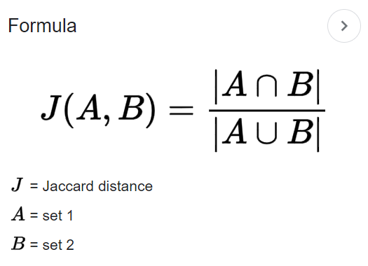
Textural similarity measures
Jaccard
The Jaccard similarity index compares members for two sets to see which members are shared and which are distinct.
It's a measure of similarity for the two sets of data, with a range from 0.0 to 1.0.

Slide 8
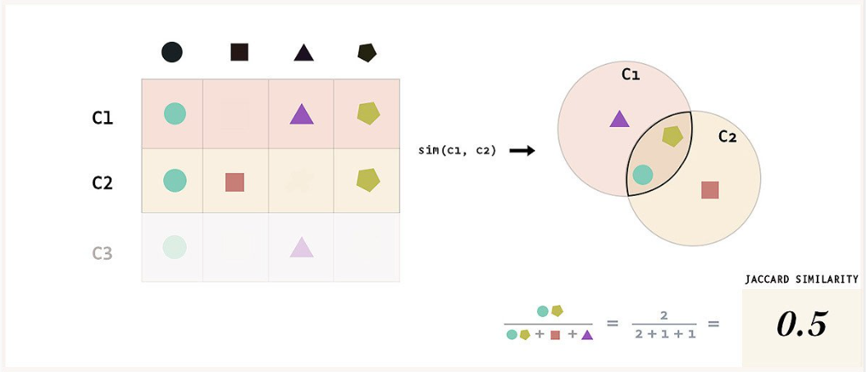
Textural similarity measures
Jaccard

Slide 9
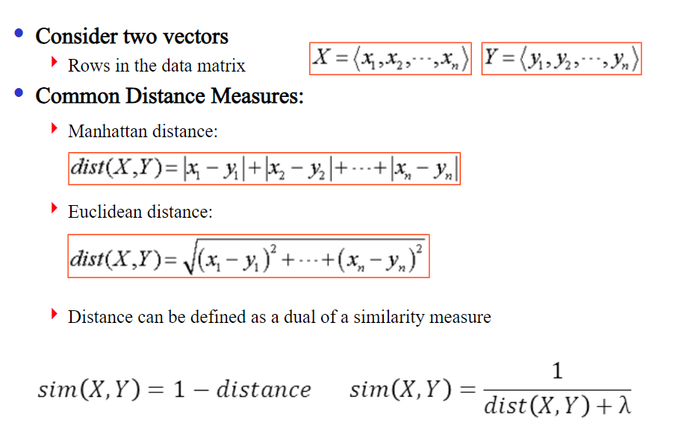
Textural similarity measures
Euclidean

Slide 10
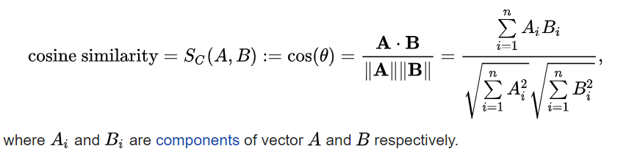
Textural similarity measures
Cosine

Slide 11
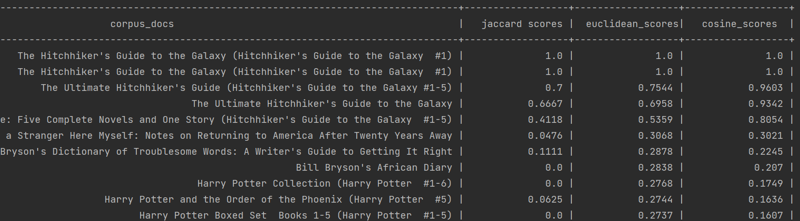
Compare Similarity Measure
Query = "The Hitchhiker's Guide to the Galaxy (Hitchhiker's Guide to the Galaxy #1)"

Slide 12
Sentence pre-processing using NLP
Raw documents (sentences) are cleaned using standard NLP techniques
Most of the pre-processing was done using the NLTK library
Summary of the pre-processing steps include:
Normalising i.e. removing unwanted characters
Tokenizing
Removing stop words
Stemming/lemmatization

Slide 13
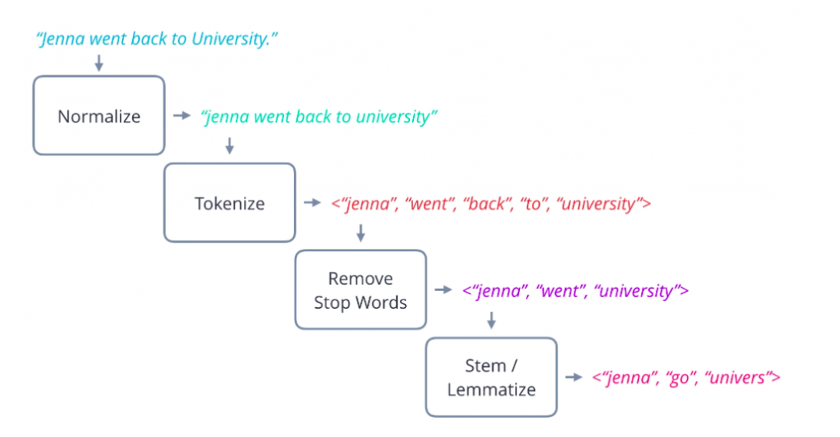
Sentence pre-processing using NLP

Slide 14
Feature engineering using Sentence Embedding techniques
Embedding techniques explored include:
TF-IDF
Word embedding with averaging
Word embedding with SIF (Smooth Inverse Frequency)
Google’s USE - (Universal Sentence Encoder)
S-Bert Encoder

Slide 15
Sentence Embedding techniques
TF-IDF
TF-IDF (term frequency-inverse document frequency) is a statistical measure that evaluates how relevant a word is to a document in a collection of documents
tf-idf(t, d) = tf(t, d) * idf(t,d)
tf(t, d): Term frequency count of t in d / number of words in d
idf(t): Inverse document frequency = log(N/(df + 1))
df(t): Number documents containing t

Slide 16
Sentence Embedding techniques
Word Embedding
word embedding is the representation of words as a real-valued vector that encodes the meaning of the word i.e. words that are closer in the vector space are expected to be similar in meaning
Word embedding is a shallow neural net prediction-based approach
Generally provides semantic meaning rather than frequency based approaches such as:
Count Vectorizer (bag of words)
TFIDF
Word embedding vectors are low/dense dimensions such as 100, 200, 500, etc
Contrast to very large/sparse vectors produced by frequency-based embeddings
Popular approaches to word embedding are:
Word2Vec (Google)
GloVe (Stanford Uni)
Fasttext (Facebook)

Slide 17
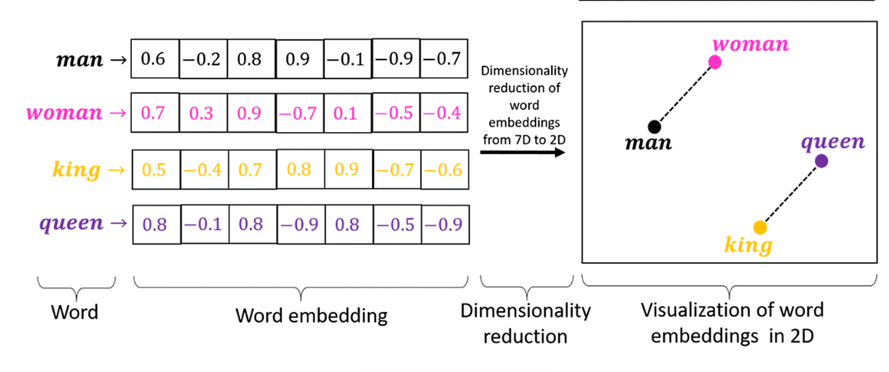
Word Embedding

Slide 18
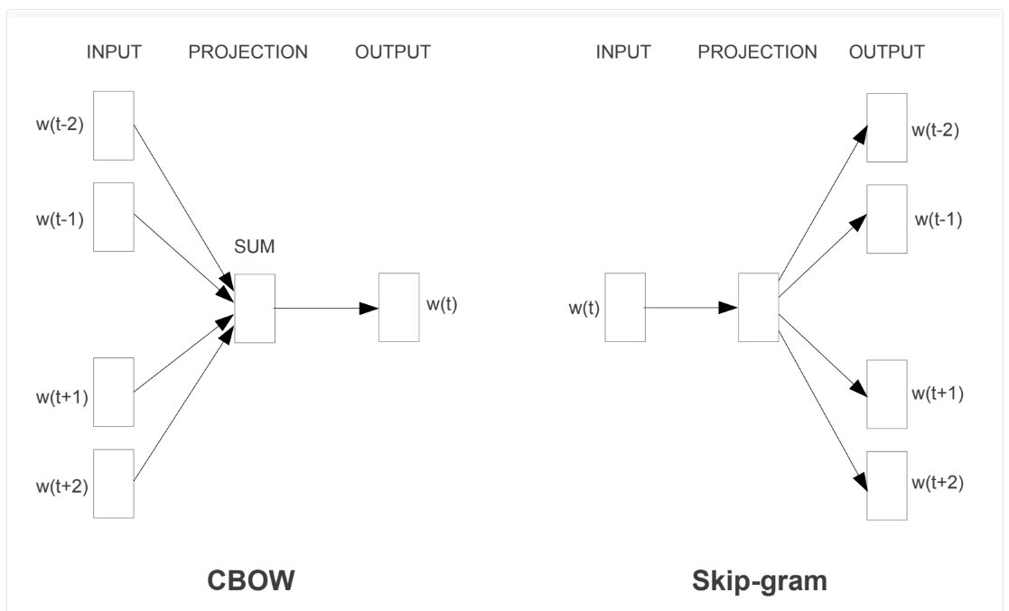
Word Embedding - Word2Vec
CBOW - Continuous bag of words
Continuous Skip Gram

Slide 19
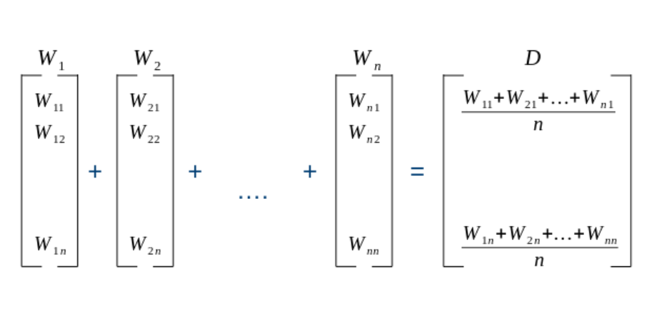
Sentence Embedding - by averaging word embeddings
S = “Hello participants of Pydata 2022!!”
W₁ = “hello”, W₂ = “participants”, W₃ = “of”, W₄= “pydata” , W₅ = “2022”

Slide 20
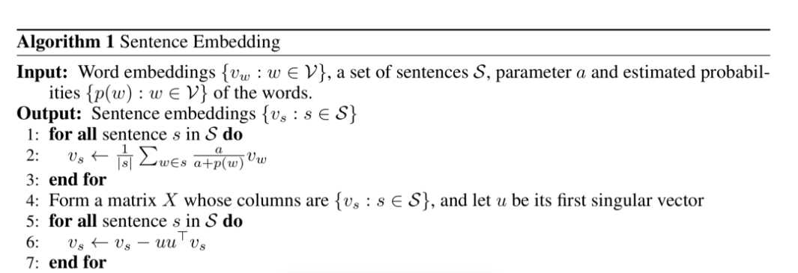
Sentence Embedding - by using Smooth Inverse Frequency (SIF)
SIF was developed by Sanjeev Arora, Yingyu Liang, Tengyu Ma in a seminal paper titled: A Simple but Tough-to-Beat Baseline for Sentence Embeddings
Sentence is embedded by a weighted average of the word vectors, and then modified a bit using PCA/SVD

Slide 21
Sentence Embedding example
Sentence =
“The Hitchhiker\'s Guide to the Galaxy (Hitchhiker\'s Guide to the Galaxy #1)”
Embedding =
[-1.8593e-02, -3.0173e-04, 3.1182e-02, -2.5220e-03, -6.8647e-03,-7.5697e-03, -1.9542e-02, 3.5058e-02, 6.2249e-02, 1.7444e-02, 6.2431e-02, 2.9910e-03, 2.3374e-02, -2.0799e-02, -2.2098e-02,-3.1721e-02, -1.6348e-02, -4.7030e-02, 2.5878e-02, -5.6786e-03, -6.3790e-02, 8.3778e-02, -1.8895e-02, 2.1439e-02, 1.6235e-02,-4.9725e-02, 7.4626e-02, 1.9593e-02, -6.2797e-02, -4.6862e-02, -3.8502e-02, 9.1784e-02, -4.3534e-02, 2.2962e-02, -8.6189e-03,-8.3778e-02, 3.5653e-02, -6.1582e-02, 1.2460e-03, -5.9104e-02, .
............ ]

Slide 22
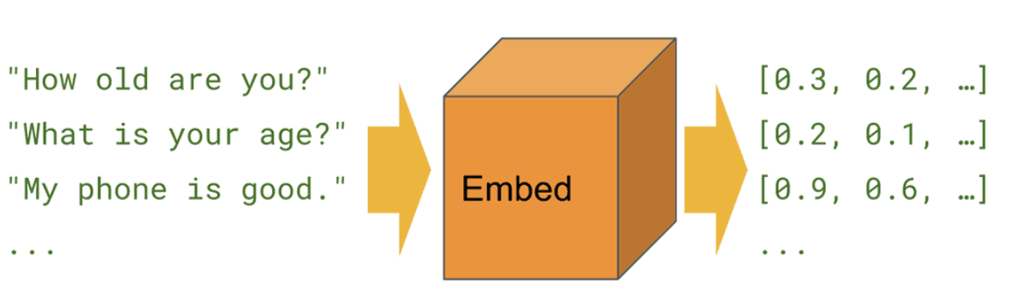
Google’s USE embedding
Google’s Universal Sentence Encoder provides a very easy solution to convert/encode sentences to embedding vectors

Slide 23
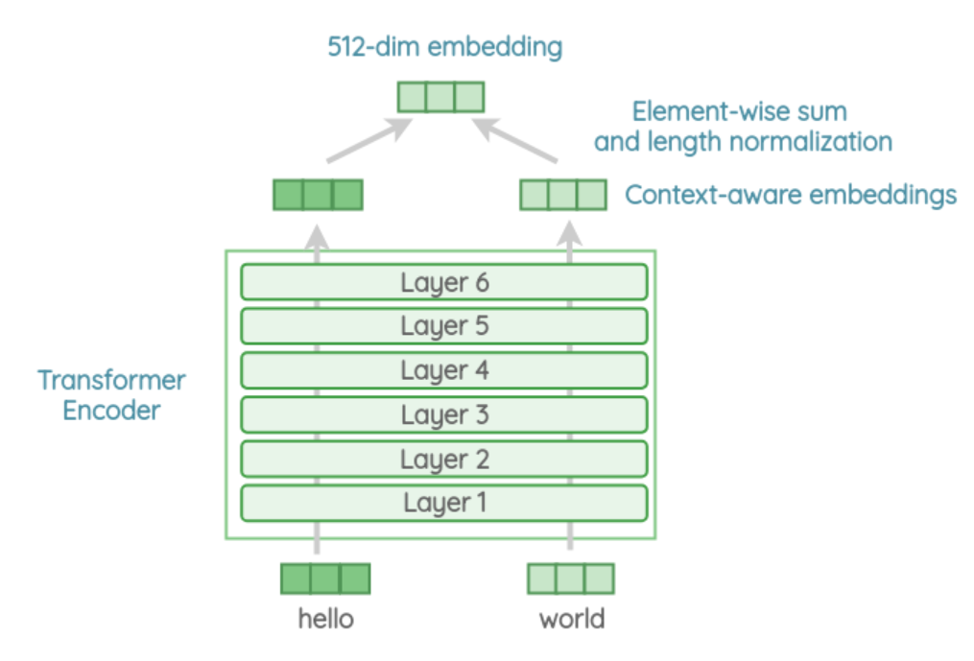
USE architecture
USE is provided in 2 variant architectures:
Transformer
DAN - Deep Averaging Network

Slide 24
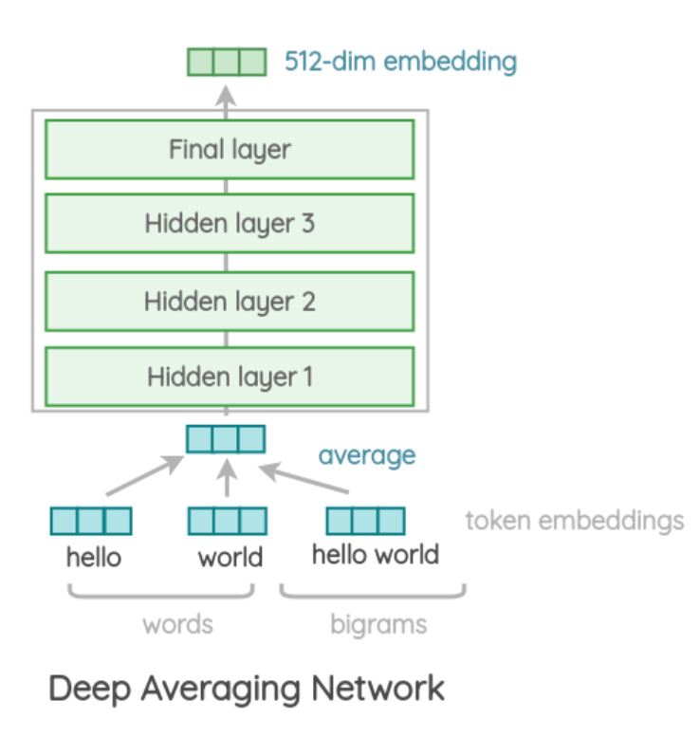
USE architecture

Slide 25
USE library/API details
import tensorflow as tf
import tensorflow_hub as hub
USE_MODEL_URL = "https://tfhub.dev/google/universal-sentence-encoder/4"
def embed(input):
return model(input)
sentence = "I am a sentence for which I would like to get its embedding."
sentence_embeddings = embed(sentence)

Slide 26
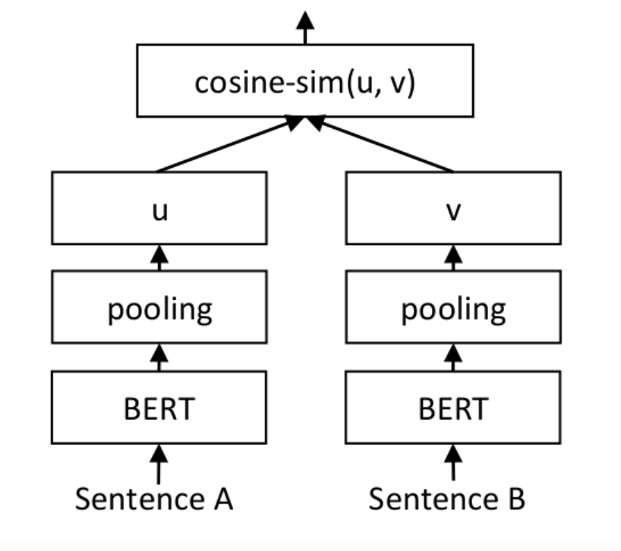
S-Bert Encoder
SBert.Net developed a very robust sentence encoder that utilizes a Siamese BERT-Networks
Details of this solution can be found in the paper titled: Sentence-BERT: Sentence Embeddings using Siamese BERT-Networks

Slide 27
S-BERT library/API details
from sentence_transformers import SentenceTransformer
model = SentenceTransformer('all-MiniLM-L6-v2')
sentences = ['This framework generates embeddings for each input sentence','Sentences are passed as a list of string.', 'The quick brown fox jumps over the lazy dog.']
sentence_embeddings = model.encode(sentences)

Slide 28
Visualizing Sentence embeddings
2-D Visualization of the sentence embeddings will provide an insight to the STS of the processed sentences
Scatter plots of the embeddings and heatmaps of similarity matrix can be very useful
But we will need to reduce the embedding dimensions to 2-D
There are number of techniques to reduce the dimensions:
PCA - Principal Component Analysis
t-SNE - t-distributed Stochastic Nearest Embedding
MDS- MultiDimensional Scaling
UMAP - Uniform Manifold Approximation & Projection

Slide 29
Dimension Reduction library/API details
PCA:
sklearn.decomposition.PCA
sklearn.decomposition.PCA(n_components=2)
t-SNE:
sklearn.manifold.TSNE
sklearn.manifold.TSNE(n_components=2)
MDS:
sklearn.manifold.MDS
sklearn.manifold.MDS(n_components=2)
UMAP
umap
umap.UMAP(n_components=2)
All four models use fit/transform api call:
<model>.fit_transform(<embedding>)

Slide 30
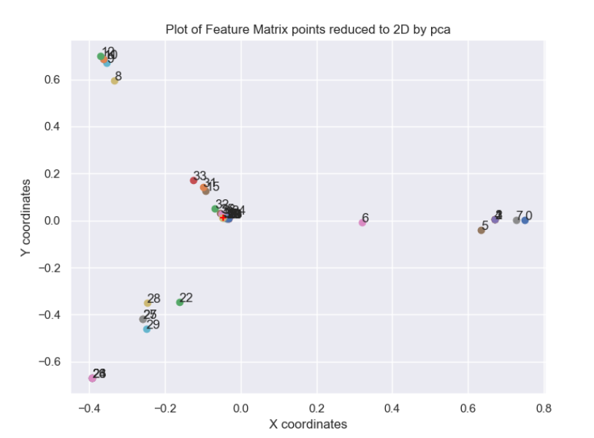
Example of PCA Visualization (tf-idf)

Slide 31
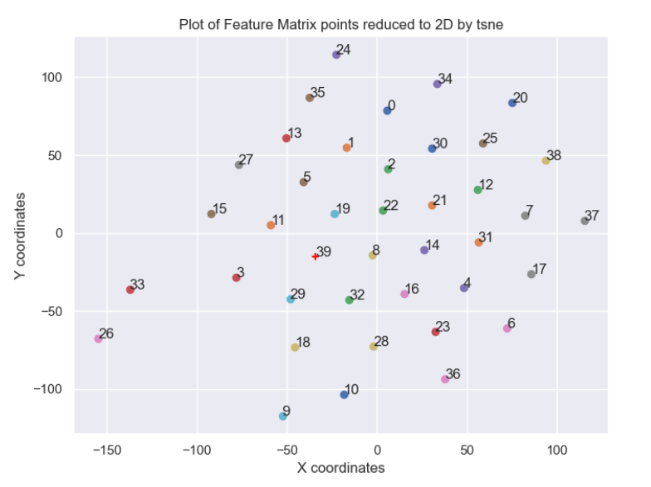
Example of t-SNE Visualization (sif)

Slide 32
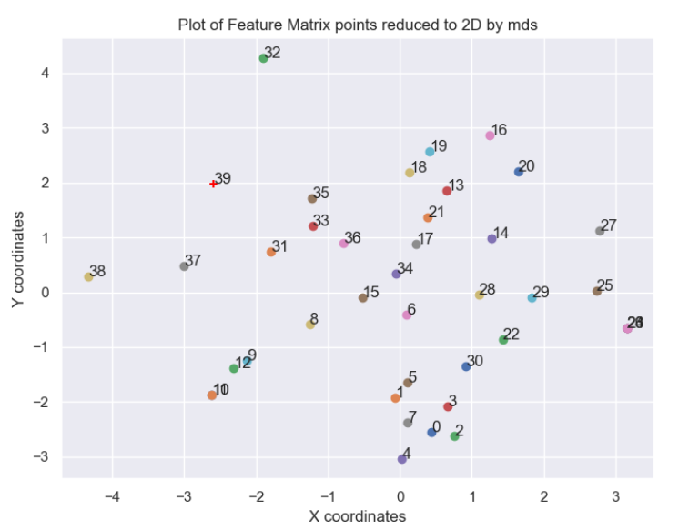
Example of MDS Visualization (use)

Slide 33
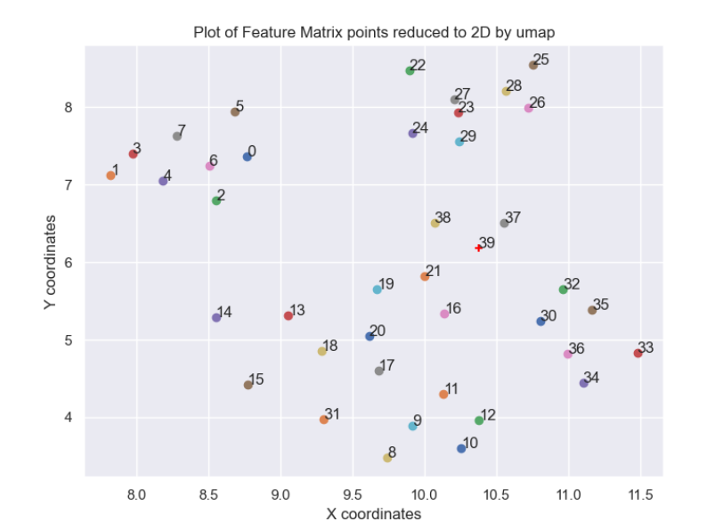
Example of UMAP Visualization (s-bert)

Slide 34
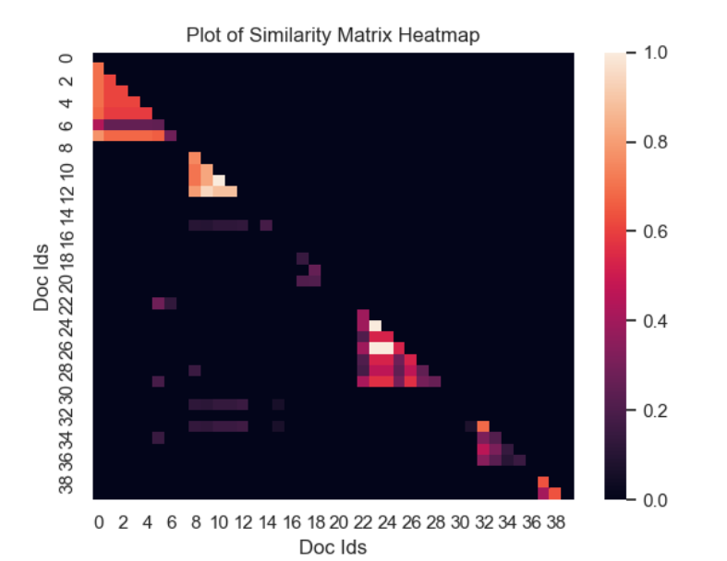
Heatmap of TF-IDF computed similarity

Slide 35
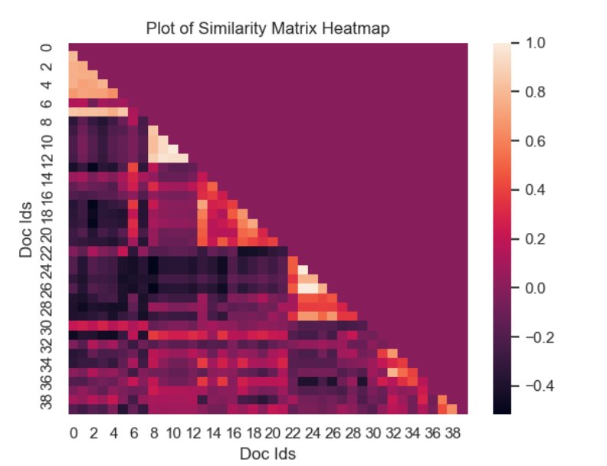
Heatmap of SIF Word Embedding computed similarity

Slide 36
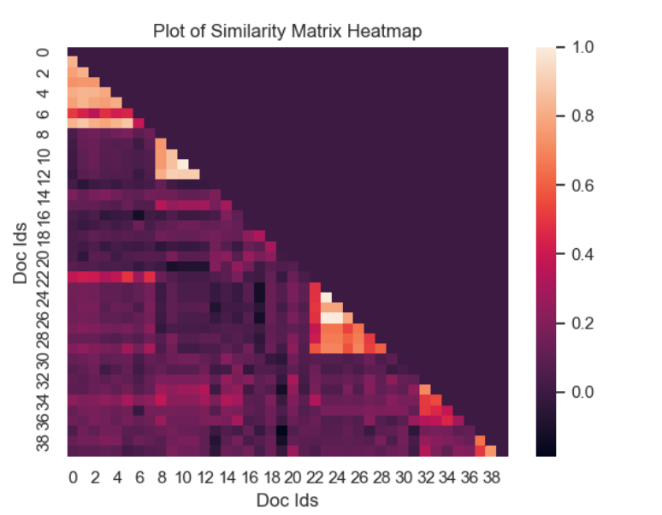
Heatmap of USE computed similarity

Slide 37
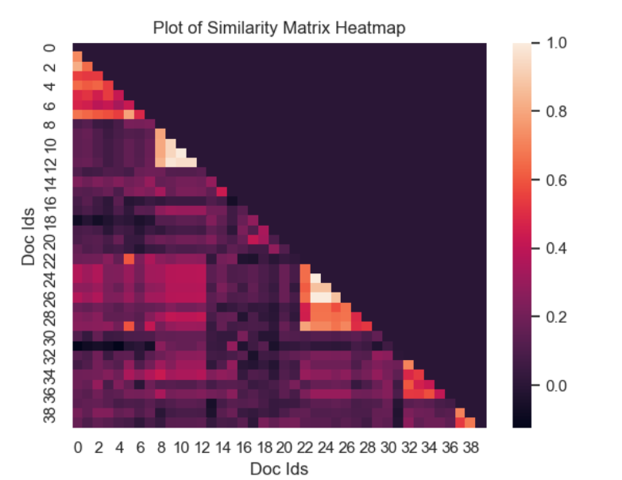
Heatmap of S-BERT computed similarity

Slide 38
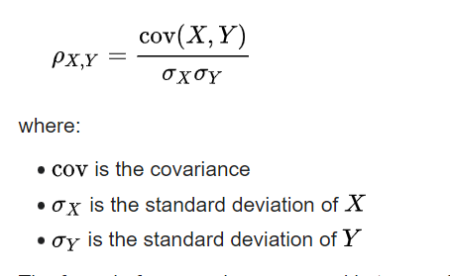
Validation of Similarity Results
The similarity results for the embedding methods were validation using Pearson Correlation metric
Pearson correlation metric computes the linear correlation between two sets of data.
This metric was used to compute the correlation between the ‘actual’ similarity (label) against the predicted similarity using any 1 of the 5 embedding approaches

Slide 39
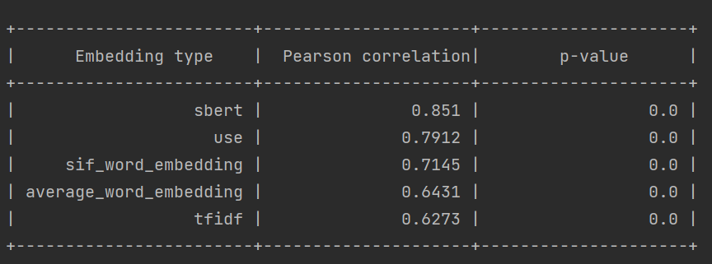
Comparison of Embedding approachs

Slide 40
Demo of Solved Problems
Simple demo the similarity between book titles
Problem: Use the 5 embedding approaches to encode the titles and compute the top k similarities between the titles
Data: Goodreads data sourced here
Demo a simple Search Engine:
Problem: User provides a query and it is compared (searched) in a corpus of documents to get the top k matches
Data: The classic 20 News Group data sourced from Scikit-Learn dataset module
Demo the performance of the 5 embedding strategies using labelled sentence pair corpus data:
Problem:
Embed the sentence pairs from the sentence pair corpus using 5 approaches
Compute the similarity between each sentence pair
Compute the performance of each approach using Paerson’s correlation coefficient i.e. computing the predicted similarity versus the actual similarity (label)
Data: STS Benchmark Sentence Pair data sourced from here

Slide 41
Demos with Q & A

